Slide 1
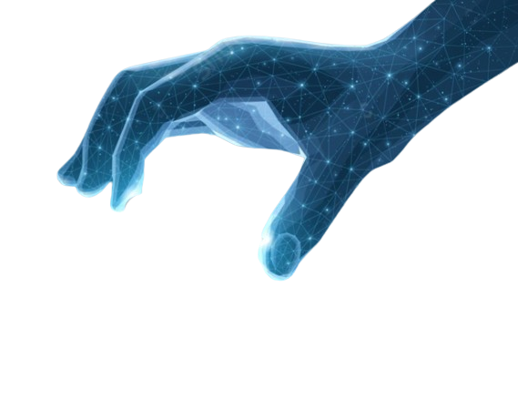


Animation
IMD316 | WEEK 7
MOHD AKMAL FAIZ OSMAN

Slide 2
COURSE OUTLINE
Types of Animation
Use of Template
Infographic Product
Typography Product
Animated Objects and Graphic Images
Tools for Creating, Editing
1

Slide 3
Types of Animation
Traditional, 2D animation, 3D animation, motion graphics, and stop motion.
Each type of animation has its own unique set of advantages and disadvantages. They’re used for different purposes, too.

Slide 4
Traditional Animation
Animation style involves drawing each frame by hand. It’s also one of the oldest forms of animation, dating back to the 1800s.
With cel animation, you ink and paint cels (sheets of celluloid) and use them in layers to create the illusion of movement.

Slide 5
Traditional Animation
The cels are then photographed one at a time to create the illusion of movement.
“Snow White and the Seven Dwarfs” is an example of traditional animation. Even the television series Spongebob Squarepants used traditional animation until 2000 when its production team made the switch from the traditional inked-and-painted cel process to a digital one.
https://youtu.be/ElXRkfVBIp0

Slide 6
2D Amination
used for traditional cartoons and anime, where characters and backgrounds are drawn by hand
These hand-drawn images are then scanned into a computer and layered to create a moving image.
2D is different from cel animation because it does not require drawings to be done for every frame. Instead, the same drawing can be used multiple times
In fact, every second of animation equals 24 frames, although most 2D animations usually animate every second frame, so 12 frames in total

Slide 7
2D Animation
Creating This makes 2D animation faster and less expensive to produce.
2D animation is still an incredibly detailed process that requires a great deal of skill and patience to create a high-quality and compelling animation.
The 2D animation process involves:
Creating a storyboard
Designing characters
Creating backgrounds
Creating a timeline and sequence of the story
Once the animation is complete, it is then rendered and composited into a single video.

Slide 8
2D Animation
Digital tools have made the process faster. For example, these days, animators can use rigging to create the character “skeleton” and then tell a computer which body parts to animate.
This way, the animator doesn’t have to draw each character for every frame.
A wonderful example of a 2D animation is Honda’s “Paper”:
https://youtu.be/vpyeQeTDGFA

Slide 9
3D Animation
3D animation uses computer animation in a 3D space. Here, several departments work together to create 3D models and character rigs, which are dropped into digital scenes.
Thanks to animation software, such as Autodesk Maya, Maxon Cinema 4D, and Blender, you can set keyframes for key actions and fill in frames in between them.

Slide 10
3D Animation
In 3D animation, you design three-dimensional characters, so that they can be viewed from every angle. 2D animation only allows you to look at a character from one side.
These models can be manipulated and animated in a much more realistic way than traditional or 2D animation. 3D animation also allows for more complex visual effects that can be integrated into the animation.

Slide 11
3D Animation
3D animation also allows for more realistic textures, lighting, shadows, and movements, which give a more immersive experience for viewers.
This short video shows you the difference between 3D and 2D animation:
https://youtu.be/Q_nn-VVXjok

Slide 12
3D Animation
3D animation was first used in commercials and shorter animated films. But the first feature-length 3D animated movie, “Toy Story” in 1995, changed the industry.
Today, 3D animation is standard and many of the jobs in the industry are specialized in 3D animation

Slide 13
Stop Animation
Stop-motion animation is similar to claymation but usually uses plastic or paper figures instead of clay.
Stop-motion requires careful planning and a lot of work, as each frame must be moved slightly and photographed in order to create the illusion of movement. Each frame is adjusted just enough, and the lighting and camera angles must be carefully planned in order to create the desired effect

Slide 14
Stop Animation
Another industry that uses stop-motion animation is the medical field. Medical stop-motion animation is used to teach students and medical professionals about anatomy, medical procedures, and surgeries.

Slide 15
Motion Capture
Motion capture is a technique that’s used to record real-life actor movements and transfer them to a digital character.
You place sensors on the actor’s body and track their movements with a camera system

Slide 16
Motion Capture
The process begins with an actor being fitted with a special suit that contains sensors and markers. The suit is connected to a computer system, and the actor is placed in a room with a camera system that tracks the sensors and markers.
The camera system then records the actor’s movements, which are then transferred to a digital character.

Slide 17
Motion Capture
The technique enhances the realism of 3D animations.
For example, motion capture was used in movies like “The Lord of the Rings”, “Avatar”, and the 2017 live action remake of “The Jungle Book.”

Slide 18
Motion Capture
This technique is used in gaming, virtual reality, and the movie industry. Motion capture technology is also being used in medical and biomechanical research to allow researchers to study the kinematics of human motion
https://youtu.be/1k5sQcqpoU0

Slide 19
Other Animation
ACTIVITY : In a group of 5 students, discuss the other types of information
Motion graphics
Anime
Rotoscoping
Cutout
Whiteboard animations
Typography animation
Clay animation
Mechanical Animation

Slide 20
Use of Templates
Envato Elements has thousands of Premiere Pro templates to choose from, all available with a monthly or annual subscription.
You can search via video template types such as “logo stings” or “titles“, or narrow your search even further by looking for particular design styles—there’s an option for every possible type of video!

Slide 21
Use of Templates
Premiere Pro templates are pre-made project files broken down into editable layers for easy customization.
As professionally made assets, templates can be a great starting point for a video project as you won’t have to start from scratch—simply make adjustments to colors, fonts, animations, and text, to create something truly bespoke.

Slide 22
Use of Templates
Video templates for Premiere Pro are especially useful for those looking to harness the power of a motion graphics suite like Adobe After Effects, without first having to learn this program inside out.
Whether you need a new YouTube opener, a series of motion graphics or inspiration for lower thirds, Premiere Pro templates can help add a professional touch to your next project.

Slide 23
Use of Templates
Save Time
Save Money
Broadcast Quality Result
Choice
Customizable
Originality

Slide 24
Use of Templates
Creating cutting-edge and quality videos has never been easier! If you’re new to Premiere Pro, the program allows you to edit, cut and create sequences from video footage.
After Effects is a program that builds effects, motion graphics and typography from scratch to layer your footage with. Premiere Pro templates integrate both Premiere Pro and After Effects together, offering ready-made video designs.

Slide 25
Use of Templates
Templates are good for beginners as you can cut and construct video sequences, and then apply motion graphics and effects built by experts. They’re also a shortcut for experienced videographers wanting to upskill and build new content.
Professional filmmakers endorse Premiere Pro as the go-to video design and editing software. It has been used to edit some of the world’s biggest box office hits such as Gone Girl, Deadpool and Terminator: Dark Fate.

Slide 26
Use of Templates
https://youtu.be/KfPIp-G1bpY

Slide 27
Infographic Product
visual representation of information about a specific product, designed to communicate key features, benefits, and other important details in a concise and engaging manner.

Slide 28
Infographic Product
Clear Purpose and Focus.
Clean Design.
Visuals.
Engaging Information & Data.
Reputable Sources.

Slide 29
Infographic Product
An effective infographic delivers data and analysis in a way that helps your audience digest and understand information easily in a visually pleasing format.
“It (infographic) keeps people's interest by lending a storytelling and visual element to what can be sterile research.”

Slide 30
Infographic Product
Infographics are used in a variety of marketing campaigns. You can use them to educate buyers about new products or services, or you can use them to enhance your marketing content by adding an eye-catching visual element.
You can also utilize them to explain how to use a product or service effectively.

Slide 31
Infographic Product
Outline your goals for creating your infographic.
Collect data for your infographic.
Make data visualizations for your infographic.
Create your layout using an infographic template.
Add style to your infographic design to make it stand ou.

Slide 32
Typography Product
Typography is the art of arranging letters and text in a way that makes the copy legible, clear, and visually appealing to the reader.
Typography involves font style, appearance, and structure, which aims to elicit certain emotions and convey specific messages.
In short, typography is what brings the text to life.

Slide 33
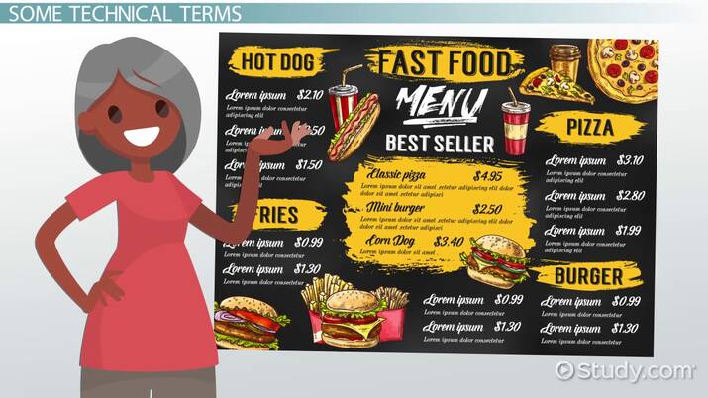
Typography Product

Slide 34
Typography Product
Typography has two main purposes in graphic design.
The first is to promote legibility, and the second is to help communicate the messaging, tone, and sentiment of a design piece.
Another function of typography revolves around aesthetics. We're drawn to visually attractive designs that are clean and easy on the eyes.

Slide 35
Typography Product
Typography is the art of creating and arranging text in a visual manner.
With all the advertising placed in front of consumers on a daily basis, it's important to design and use type in such a way that it attracts the reader's attention and gives them a clear understanding of your message.

Slide 36
Animated Objects and Graphic Images
Graphics are visual images or designs on some surface, such as a wall, canvas , screen, paper, or stone to inform, illustrate, or entertain.
Animation is the process of making the illusion of motion and the illusion of change by means of the rapid succession of sequential images that minimally differ from each other..

Slide 37
Animated Objects and Graphic Images
Motion graphics can bring statistical data to life, but animation can bring characters to life with emotional narratives, creativity, and artistic expression.

Slide 38
Animated Objects and Graphic Images
Animators work to give clients animation for entertainment purposes, while graphic designers work to provide clients with marketing material. Graphic designers do this by creating a layout for the client that will help them sell their product. Their designs help the client display what they sell.

Slide 39
The End of Chapter 6
akmalfaiz@uitm.edu.my
School of Information Science,
College of Computing, Informatics and Mathematics
Universiti Teknologi MARA (UiTM)

